Slide 1


micro:bit entry video tutorial
Lesson 4
micro:bit basic lesson 4 “DIY thermometer ”
YahBoom micro:bit video tutorial

Slide 2
micro:bit entry video tutorial
Content
Part1
Part 2
Part3
Part 4
Part 5
Learning goals
Preparation
Search for blocks
Combine blocks
Tips
YahBoom micro:bit video tutorial

Slide 3
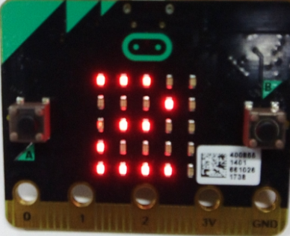
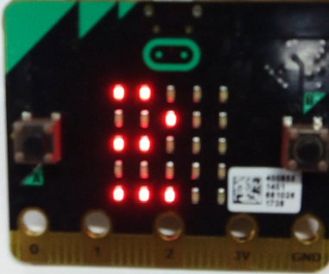
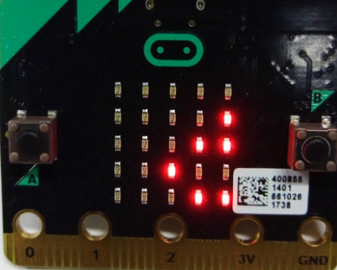
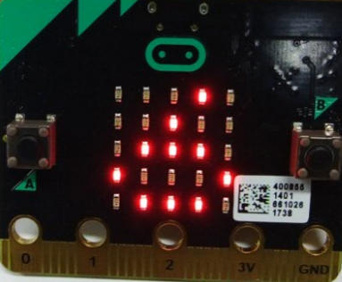
micro:bit entry video tutorial
Part 1
Learning goals
After you have downloaded the program, you can see the value of the temperature on the micro:bit's dot matrix to the left. At present, the teacher has measured the temperature of 26 degrees Celsius. The students can try to see how much the temperature is around you.
YahBoom micro:bit video tutorial

Slide 4
micro:bit entry video tutorial
Part 2
Hardware:
● 1 X Micro: bit Board
● 1 X Micro USB Cable
● 2 X AAA batteries
Preparation
Then the micro:bit is connected to the computer through USB, and the computer will pop up a U disk and click the URL in the U disk to enter the programming interface.
YahBoom micro:bit video tutorial

Slide 5
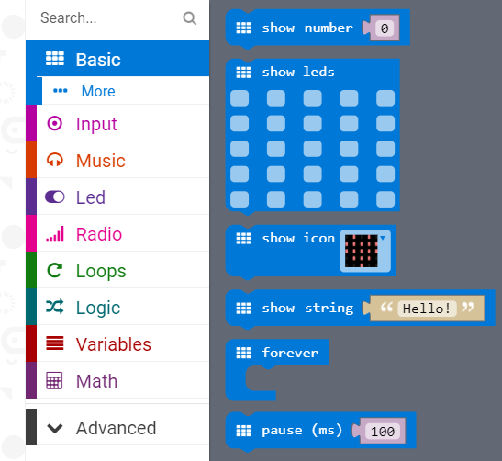
micro:bit entry video tutorial
Part 3
Search for blocks
YahBoom micro:bit video tutorial

Slide 6
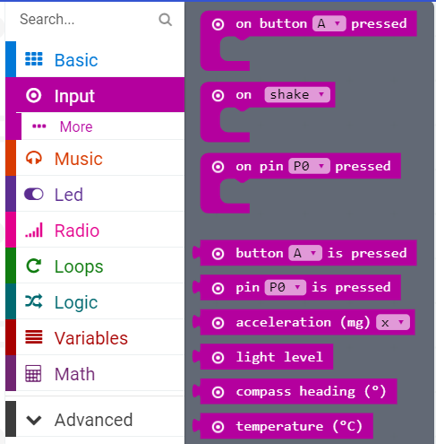
micro:bit entry video tutorial
Part 3
Search for blocks
YahBoom micro:bit video tutorial

Slide 7
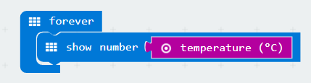
micro:bit entry video tutorial
Part 4
Combine blocks
YahBoom micro:bit video tutorial

Slide 8



micro:bit entry video tutorial
Part 5
Do you learn the course today?
If you learn to do it, give yourself a top quack.
Now you have learned how to use the thermometer in micro:bit.
But do you know what the temperature means?
Tips
Temperature is the physical quantity that represents the degree of cold and heat of a body. Microscopically speaking, it is the intensity of the thermal movement of an object molecule. In this experiment, we measured the Celsius temperature. The inventor was Anders Celsius, the freezing point was 0 degrees, and the boiling point was 99.974 degrees. So what are your temperature now, children?
YahBoom micro:bit video tutorial

Slide 9
micro:bit entry video tutorial
micro:bit
project
Thanks for watching！
Powered by YahBoom
YahBoom Micro:bit video tutorial

